Slide 1
Independent Samples t-test

Slide 2


How do we know it’s a Banana?
Is there a difference, on average, given two reflective samples?
How does a machine know it’s a banana?
Notes:
For the demo we will test whether homes with a full, finished basement on average have a higher selling price. This image is related to that example research question

Slide 3
Using the independent samples t-test to compare means Windsor, ON housing prices
What hypotheses will you test?
Are all measurements independent?
Are there adequate sample sizes for each sample?
Is each sample normally distributed?
At what confidence level will the test be conducted?
Notes:
This is a real dataset from the Journal of Applied Econometrics. Read about it here: https://rdrr.io/rforge/Ecdat/man/Housing.html

Slide 4
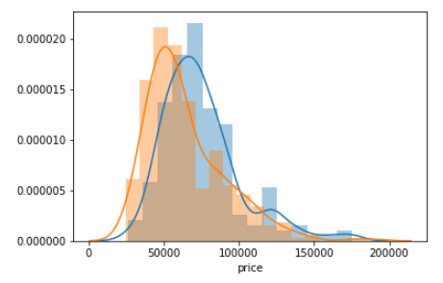
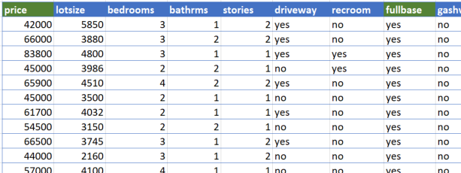
Independent samples t-test walk-through
Is there likely to be a real difference in population means, given the samples?
Mean of a normally distributed, continuous variable
Two categories

Slide 5
Conducting an independent samples t-test
Null hypothesis: there is no significant difference in means.
Alternative hypothesis: there is a significant difference in means
Test statistic > critical value: reject the null

Slide 6
Evaluating an independent samples t-test
Critical value for 95% confidence level: 1.96
P-value for 95% confidence level: <.05
95% confidence level: probability that true (population) difference in means falls within the inferred range of values

Slide 7
Independent samples t-test Let’s walk through this using the Jupyter Notebook

Slide 8
Summary
When to use an independent samples t-test
Assumptions of the t-test
Framing & testing hypotheses
Evaluating a t-test: test statistic, p-value

